Slide 1
Syracuse
Trailblazers
July 14
2020

Slide 2
Connecting
Trailblazer Community Groups: Syracuse, NY Developers Group
How we track membership, schedule meetings and RSVP to upcoming events
Twitter: @syracusedevs
Posting formal meetups, informal gatherings, retweeting regional events and member activities
Chatter: Syracuse, NY Developers Group
Conversations and discussions with other group members
Web: SyracuseDevelopers.com
Links to the above sites, copies of slides/code presented at meetups

Slide 3
Summer 20
This presentation has not been created by Salesforce, Inc but is based on forward looking statements.
Statement under the Private Securities Litigation Reform Act of 1995:
This presentation may contain forward-looking statements that involve risks, uncertainties, and assumptions. If any such uncertainties materialize or if any of the assumptions proves incorrect, the results of salesforce.com, inc. could differ materially from the results expressed or implied by the forward-looking statements we make. All statements other than statements of historical fact could be deemed forward-looking, including any projections of product or service availability, subscriber growth, earnings, revenues, or other financial items and any statements regarding strategies or plans of management for future operations, statements of belief, any statements concerning new, planned, or upgraded services or technology developments and customer contracts or use of our services.
The risks and uncertainties referred to above include – but are not limited to – risks associated with developing and delivering new functionality for our service, new products and services, our new business model, our past operating losses, possible fluctuations in our operating results and rate of growth, interruptions or delays in our Web hosting, breach of our security measures, the outcome of any litigation, risks associated with completed and any possible mergers and acquisitions, the immature market in which we operate, our relatively limited operating history, our ability to expand, retain, and motivate our employees and manage our growth, new releases of our service and successful customer deployment, our limited history reselling non-salesforce.com products, and utilization and selling to larger enterprise customers. Further information on potential factors that could affect the financial results of salesforce.com, inc. is included in our annual report on Form 10-K for the most recent fiscal year and in our quarterly report on Form 10-Q for the most recent fiscal quarter. These documents and others containing important disclosures are available on the SEC Filings section of the Investor Information section of our Web site.
Any unreleased services or features referenced in this or other presentations, press releases or public statements are not currently available and may not be delivered on time or at all. Customers who purchase our services should make the purchase decisions based upon features that are currently available. Salesforce.com, inc. assumes no obligation and does not intend to update these forward-looking statements.

Slide 4
Summer 20
Sunsets
Lightning
Mobile
Flows
Developer

Slide 5
Summer 20
Release Notes
https://releasenotes.docs.salesforce.com/en-us/summer20/release-notes/salesforce_release_notes.htm
Unofficial Snarky Abridged Edition
https://www.reddit.com/r/salesforce/comments/gqu0g3/summer_20_release_notes_abridged_edition/
Trailhead
https://trailhead.salesforce.com/en/content/learn/modules/summer-20-release-highlights

Slide 6
Sunsets
Original Territory Management
Retired
Migrate to Enterprise Territory Management
ETM now supported in LEX
Customizable Forecasting
Retired
Move to Collaborative Forecasts

Slide 7
Sunsets
Data.com Prospector and Data.com Clean
Can no longer be renewed
Retiring on July 31, 2020
Data Recovery Services
Paid add on service
Last resort to restore/recover org data
Switch to Data Loader, API exports or AppExchange partner
Retiring on July 31, 2020

Slide 8
Sunsets
Page Layouts
To be effectively replaced by Dynamic Forms & Dynamic Actions
In beta, releasing in stages over the next year
Page Layouts will be around for a while, especially for Classic users
Process Builder
To be effectively replaced by Flows
Process Builder functionality continues to move into Flows
Platform builders really need to start learning Flows

Slide 9
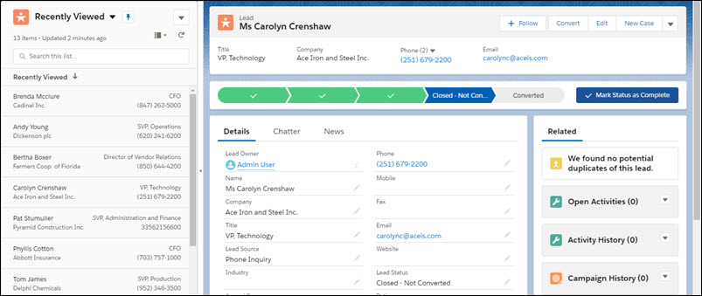
Lightning
Path Guidance for Success in Kanban View (Demo-Opportunities)
Path guidance and key fields are available in the kanban view
New ‘Show more details’ button next to pie chart
Kanban Confetti (Demo)
Why not?
You can confetti in more than just the last stage
Split View (Demo)
Now available outside the console
Only available for objects that are on the nav bar

Slide 10
Lightning
CSV in Report Subscriptions (Beta)
Attach a csv file to your report subscription
No report data in the email’s body when there is an attachment
Must open the csv to see the report data
Without an attachment, report subscriptions behave the same way as before, with data in the email body

Slide 11
Lightning
Help uses trailblazer.me Profile Now
Salesforce Help is now accessed through your trailblazer.me profile
This is the same profile used for Trailhead, Success community, etc
You can merge your production and private accounts in trailblazer.me
Salesforce Partners and Consultants are having trouble accessing help on behalf of their clients
Einstein OCR is Generally Available
Detect alphanumeric text in signs, business cards, photos, etc
Part of Einstein Vision
REST API that responds with JSON

Slide 12
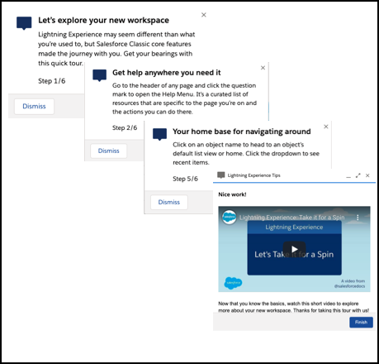
Lightning
In-App Guidance
Slight UI revamp
Walkthrough mode for myTrailhead users
Allows chaining up to 10 prompts together
Related Record Component (Demo)
New standard option for lightning pages
Look 2 levels up instead of just 1
See related ObjC through ObjB on ObjA

Slide 13
Lightning
Dynamic Forms (Beta, Demo)
Configure fields on a lightning page
Decouples fields from page layouts
Allows for conditional visibility and conditionally ‘required’ fields
Currently only supported on custom objects
Dynamic Actions (Beta, Demo)
Configure actions on a lightning page
Decouples actions from page layouts
Allows for conditional visibility
Currently only supported on custom objects and Desktop
Current Roadmap
Summer 20 - Beta
Winter 21 - GA for Custom Objects
Spring 21 - GA for Standard Objects
Summer 21 - GA for Mobile Support

Slide 14
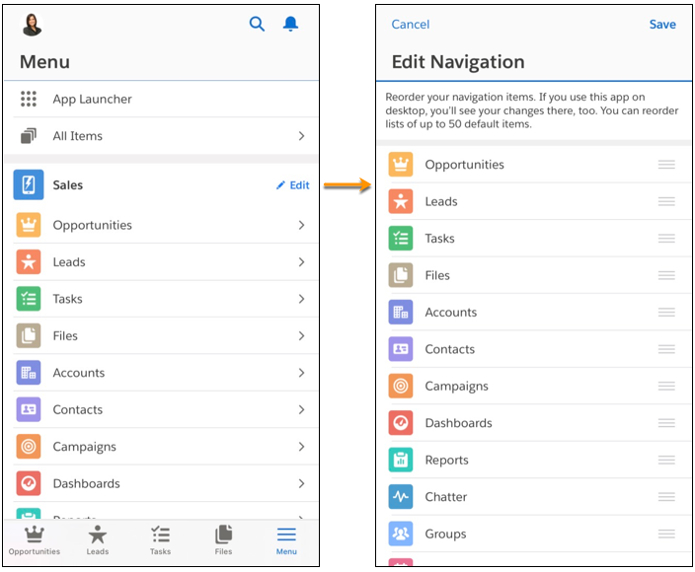
Mobile
Reorder Navigation Items
Change tab order, just like you can on desktop
Desktop and mobile share tab ordering
Admin can disable personalization per app
Items that are mobile only (like “Today”) cannot be reordered

Slide 15
Mobile
Mobile Activity Reminders (Pilot)
Receive task and event reminders in the app
Push notifications to mobile device
Supports Android and iOS
Contact Account Exec to enable this pilot feature
Higher Notification Limits
Send up to 20,000 iOS push notifications per hour per org
Send up to 10,000 Android push notifications per hour per org

Slide 16
Mobile
Enhanced Mobile Security Options
This is available for an extra cost
New mobile custom attribute options
Some options include Detect Jailbroken, Detect New Biometric ID, Enforce Maximum Days Offline, Prohibit 3D Touch, Prohibit Camera, Prohibit File Backups, Prohibit Microphone, Prohibit Share Actions, Require Device Passcode, Require Logout After Device Restarts, Require Minimum Version of OS

Slide 17
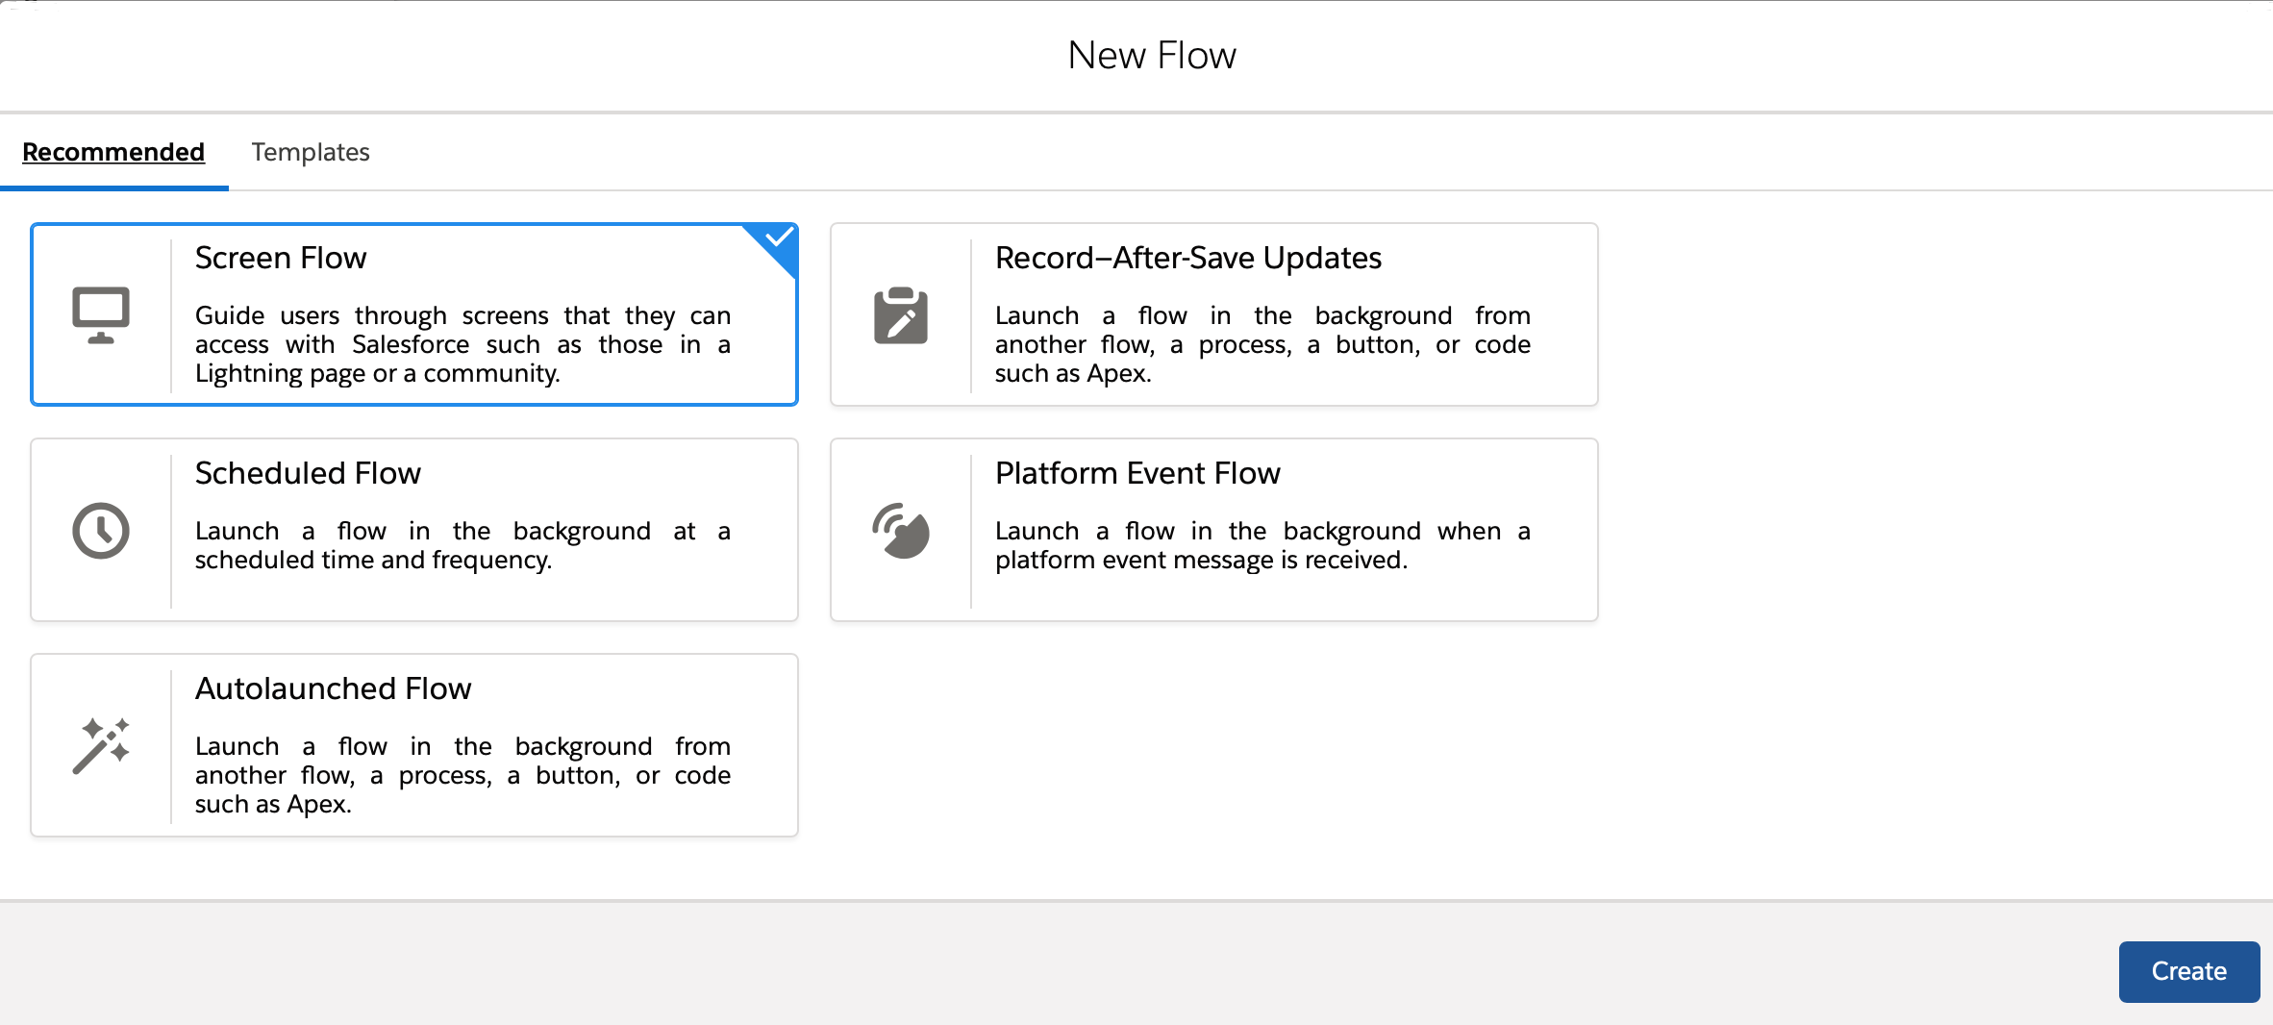
Flows

Slide 18
Flows
After Flows
Flows can run after a record is saved, like an After Trigger
Use for actions like send an email
Access field values that are set only after the record is saved, such as the Last Modified Date
Moves some Process Builder functionality into Flows
Before Flows
Flows can run before the Before Triggers
Update your Order of Execution diagrams

Slide 19
Flows
Traditional Order of Execution
Change Record
Before Triggers
After Flows
Before Triggers Refire
Changes Saved
Using a Before Flow’s Order of Execution
Change Record
Before Flows
Before Triggers
Before Triggers Refire
Changes Saved

Slide 20
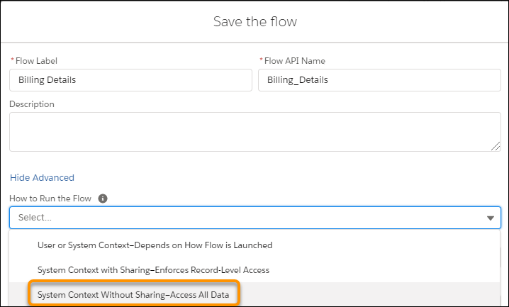
Flows
Run in User Mode
Your permissions are whatever the admin sets them to
Run in System Mode With Sharing
You can do anything and access any field, but only with records you can see
Run in System Mode Without Sharing
You have the potential to screw up everything

Slide 21
Flows
Platform Events
Flows can subscribe to a platform event
Auto run upon receiving the event
Unlike Process Builder, you don’t need to associate this flow with a particular Object
Moves some Process Builder functionality into Flows

Slide 22
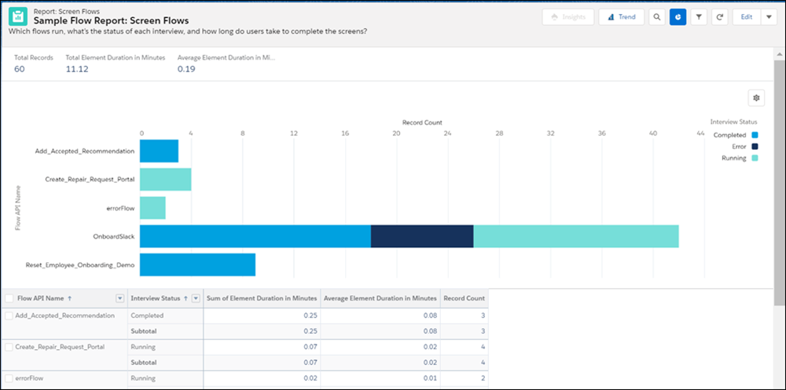
Flows
Analyze Screen Flows Report
New Sample Flow Report: Screen Flows report type
Generate a log entry for each screen flow run in the last 31 days
See number of times the flow was run
See Running, Paused, Completed count
See total and average element duration time

Slide 23
Flows
Track Flow Limits
Debug logs can now track the resource consumption of each finished flow interview
08:45:05.127 (4741320574)|FLOW_INTERVIEW_FINISHED|31428290809e63dc5961431e12c7171c0d7b8fe-4c02|MyFlow
08:45:05.127 (4741384571)|FLOW_INTERVIEW_FINISHED_LIMIT_USAGE|SOQL queries: 1 out of 100
08:45:05.127 (4741396008)|FLOW_INTERVIEW_FINISHED_LIMIT_USAGE|SOQL query rows: 75 out of 50000
08:45:05.127 (4741404708)|FLOW_INTERVIEW_FINISHED_LIMIT_USAGE|SOSL queries: 0 out of 20
08:45:05.127 (4741413424)|FLOW_INTERVIEW_FINISHED_LIMIT_USAGE|DML statements: 75 out of 150
08:45:05.127 (4741421017)|FLOW_INTERVIEW_FINISHED_LIMIT_USAGE|DML rows: 75 out of 10000
08:45:05.127 (4741428079)|FLOW_INTERVIEW_FINISHED_LIMIT_USAGE|CPU time in ms: 1958 out of 15000
08:45:05.127 (4741457291)|FLOW_INTERVIEW_FINISHED_LIMIT_USAGE|Heap size in bytes: 1043 out of 6000000
08:45:05.127 (4741465282)|FLOW_INTERVIEW_FINISHED_LIMIT_USAGE|Callouts: 0 out of 100
08:45:05.127 (4741471652)|FLOW_INTERVIEW_FINISHED_LIMIT_USAGE|Email invocations: 0 out of 10
08:45:05.127 (4741477919)|FLOW_INTERVIEW_FINISHED_LIMIT_USAGE|Future calls: 0 out of 50
08:45:05.127 (4741484005)|FLOW_INTERVIEW_FINISHED_LIMIT_USAGE|Jobs in queue: 0 out of 50

Slide 24
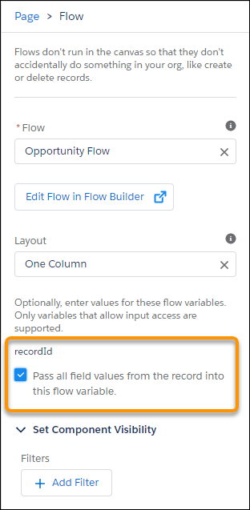
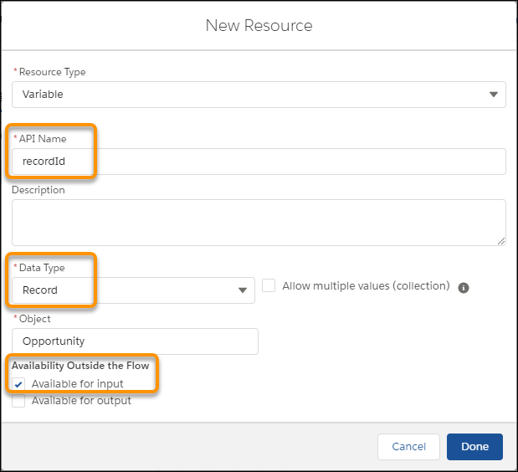
Flows
Flow Debug Mode
Rollback in debug mode option
Changes won’t be saved to database
Only for autolaunched flows
Record ID Automatically Passed
Create a record variable in your flow named “recordId” and mark it available for input
On lightning page, new option “Pass all field values from the record into this flow variable”

Slide 25
Developer
Lightning Messaging Service now Generally Available
Use Lightning message service to communicate across the DOM
Communicate between Visualforce pages, Aura components, Lightning web components
Communicate between components within a single Lightning page or across multiple pages.
Custom Notifications to External Apps
Your custom notifications can now be sent to Connected Apps
Subscribe a connected app to a custom notification in the App Manager

Slide 26
Developer
Lightning Web Components Can Share CSS
You can now import a CSS file to multiple LWCs
Easier to provide a consistent look and feel
Sandbox Track Source Changes (Beta)
Scratch Orgs had this feature, now available for traditional sandbox developers
Enable in a Developer or Developer Pro sandbox
Automatically tracks changes between the sandbox and the local workspace
Push/pull changes between your project and sandbox using VSCode and sfdx

Slide 27
Release Plan
Release has been pushed from June to July due to Covid-19
Sandboxes refreshed before May 29 should be on Summer 20
Production release on July 10th or July 18th, depending on your instance

Slide 28
Thank You For Coming!
Next Meetup
TDX Global Gathering (Virtual Event)
August 3rd, 4:00p-6:00p
Giving away $800 in certification vouchers!
Special Guest: Mohith Shrivastava
Lead Developer Evangelist, Salesforce
Upstate at Home (Virtual Event)
August 26th, 11:00a-3:00p

