Slide 1
EINSTEIN ANALYTICS

Slide 2
Emily Morse Senior Cloud Consultant, Cloud for Good
5 years nonprofit experience, focused in data management and program evaluation
3 years Salesforce experience
Salesforce certifications and accreditations: Administrator, Sales Cloud Consultant, Nonprofit Cloud Consultant, Platform App Builder, and Einstein Analytics Advanced Accreditation
MS Psychology, Villanova University
MSW, University of Pittsburgh
Located in Syracuse, NY

Slide 3
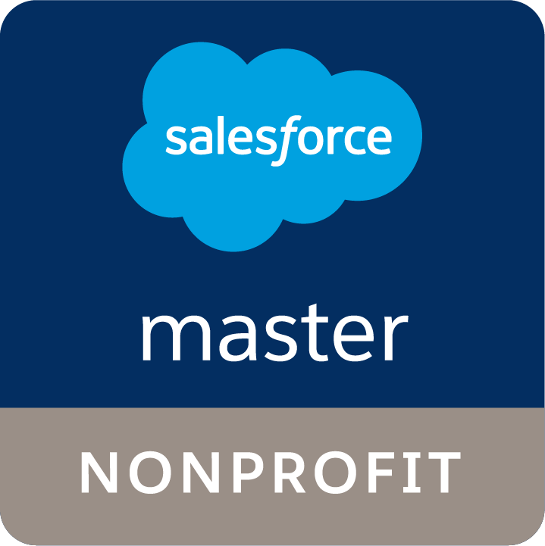
CLOUD FOR GOOD
Founded in 2010 after realizing the transformation power Salesforce can have on all organizations and institutions | Headquartered in North Carolina, with 60 consultants across the US, Canada and the Netherlands | 1,400 + Salesforce Implementations
Salesforce Master in the Nonprofit Designation | Industry Expertise in Nonprofits, Higher Education & Healthcare | 200 Certifications & Thousands of Trailhead Badges Collectively

Slide 4
INTRO TO EINSTEIN

Slide 5
PRODUCT BREAKDOWN

Slide 6
STANDARD SALESFORCE REPORTS & DASHBOARDS
Data must be in Salesforce (or using Salesforce Connect)
Limitations on size of data set (2000 rows)
Great new features in Lightning!

Slide 7
EINSTEIN ANALYTICS
What it IS:
Enhancement to standard reports & dashboards
Designed for end-users
Capable of including external data
A tool to get insight into your data and make it actionable
What it’s NOT:
A Business Intelligence (BI) tool such as Tableau
A tool for data analysts

Slide 8
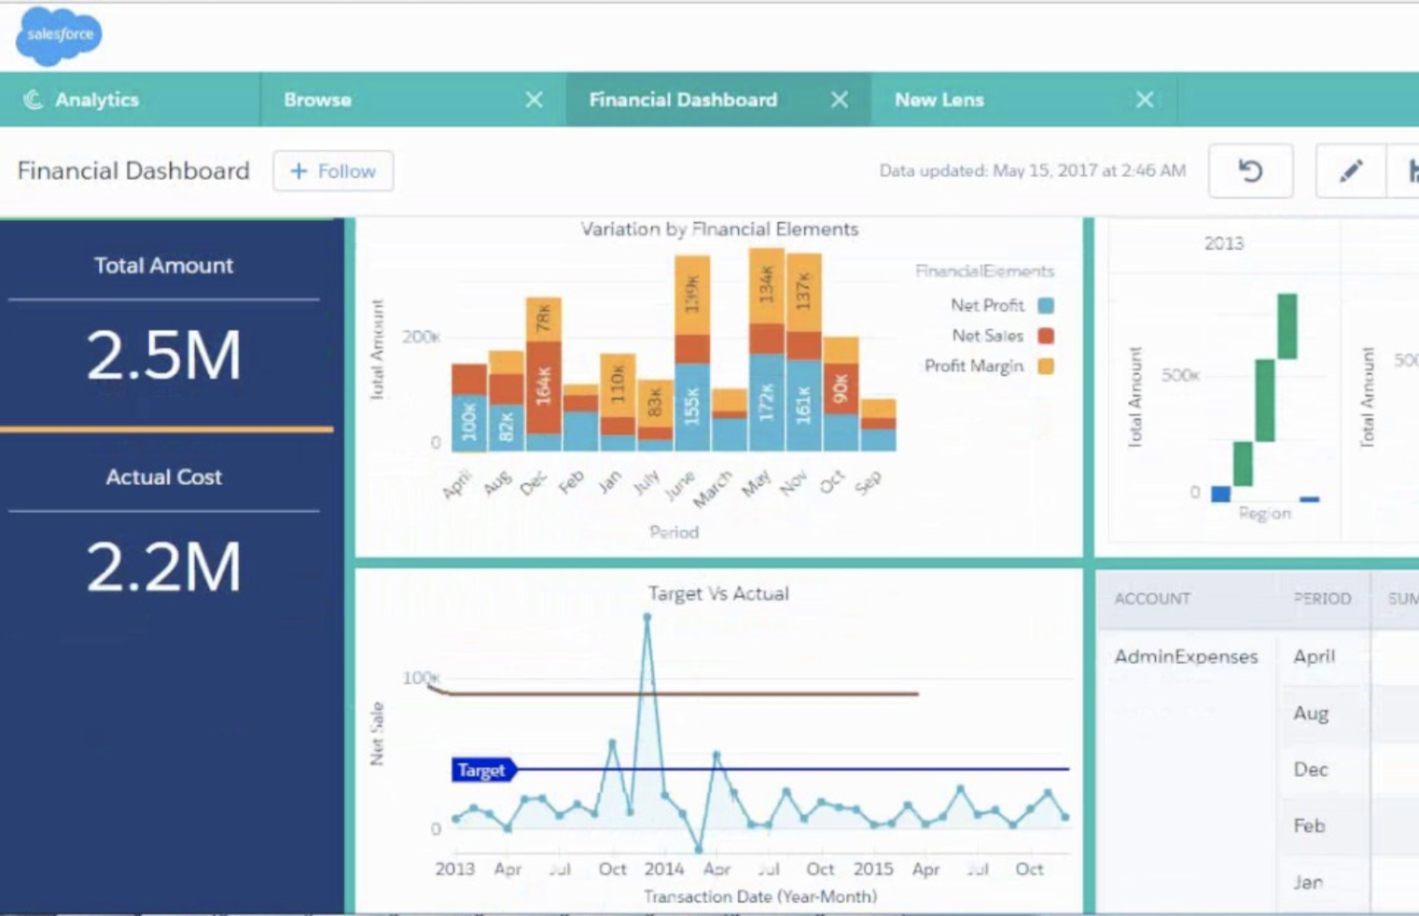
L
E
N
S
L
A
Y
E
R

Slide 9
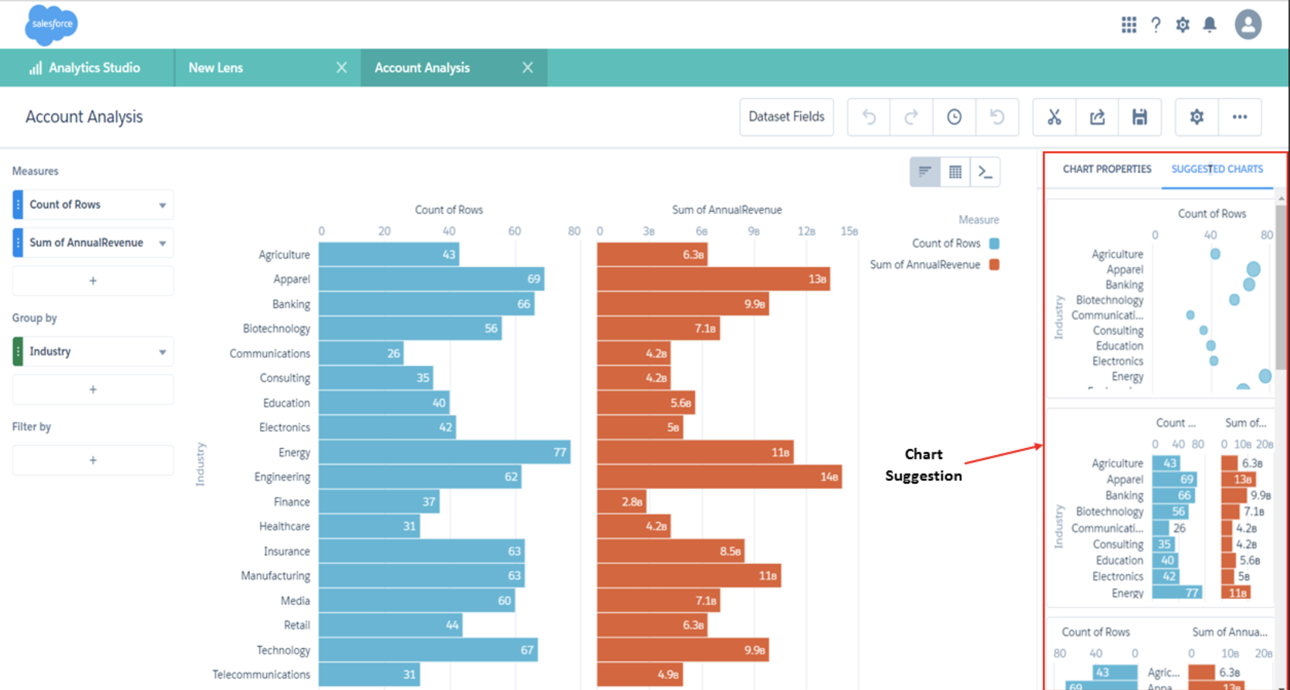
L
E
N
S
L
A
Y
E
R

Slide 10
L
E
N
S
L
A
Y
E
R

Slide 11
DESIGN RECOMMENDATIONS

Slide 13
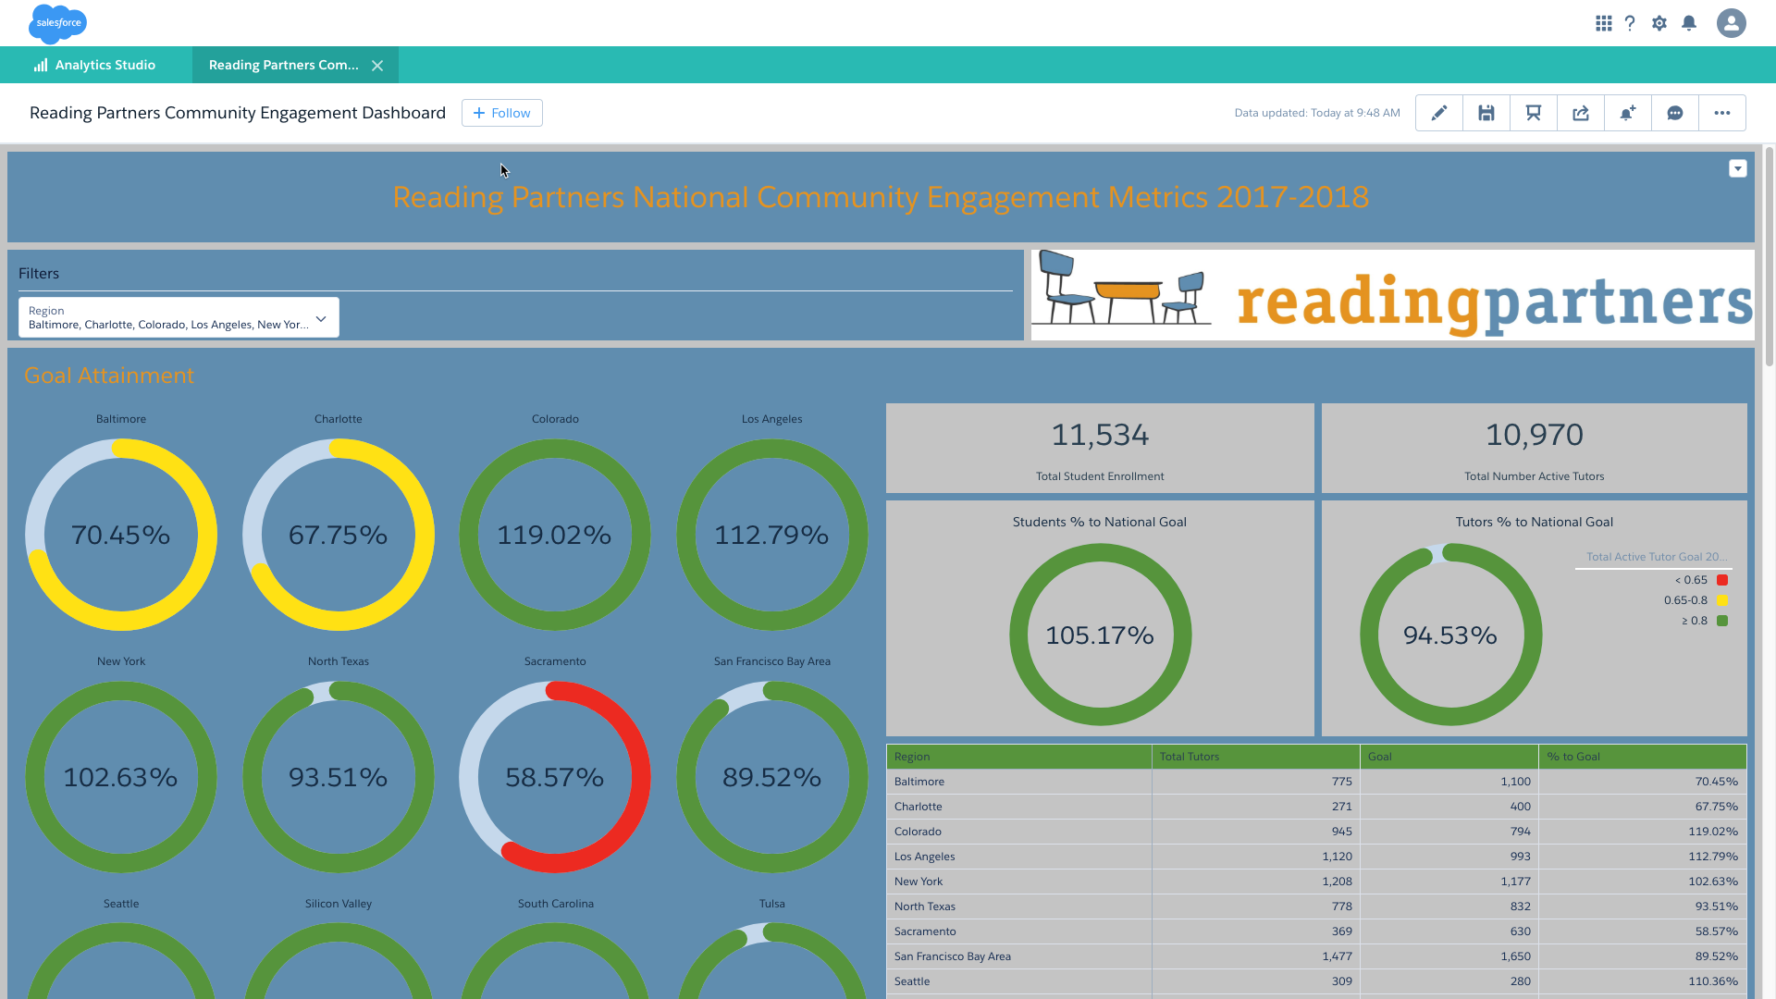

Slide 14
Bring External Data Into Analytics
Load external data directly into an Einstein dataset from a .csv file or from Microsoft Excel
Analytics automatically generates the metadata (i.e., fields for the columns in your file), which you can preview and change
Salesforce Einstein Analytics Connector for Excel makes it easy
Connect and sync to data inside and outside of your Salesforce org using Analytics Connectors
Many connector types available
Connector types include Google BigQuery, used for Google Analytics connection

Slide 15
Einstein Data Security
Use Salesforce “Integration User” and “Security User” to get data from Salesforce into Einstein, and to customize access
Create folders of apps and dashboards which can be shared or private in Einstein
Configure row-level (i.e., like record level) security within datasets for Analytics Users
This can be done by configuring security predicates in Einstein, or enabling Einstein to inherit your Salesforce sharing rules

Slide 16
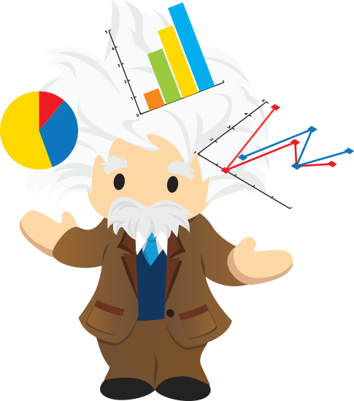
Implementation Considerations
Understand the questions are you trying to answer from your data
Assess how much data do you have
Review the complexity of your underlying data
Identify the different systems you’ll want to integrate
Consider the maturity of your Salesforce adoption
Consider you organizational resources
Understand the cost
Evaluate the potential return on investment

Slide 17
Einstein Readiness Assessment
Sales Cloud Einstein Readiness Assessor:
Analyzes your Salesforce instance and sends you a personalized report with recommendations (such as settings to enable) to prepare you to leverage Einstein better

Slide 18
Fundraising Analytics Template
Helps you get started on Einstein with your fundraising data
Works with NPSP
Includes pre-built dashboards, but can also be customized
Uses Account and Opportunity data

Slide 19
EINSTEIN DEMO

Slide 20
Q & A

Slide 21
OTHER PRODUCTS

Slide 22
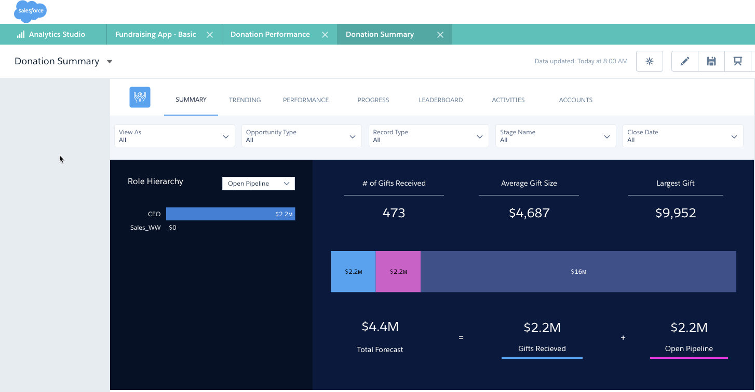
Fundraising Analytics Template
Go to Analytics Studio > Create App > From Template > select Fundraising Analytics.
Requires the following: Accounts, Opportunities, at least one task and one event
Refers to Opportunities as "Donations"
Provides a basic, out-of-the-box version and a version that can be customized with Cases or Campaigns

Slide 23
EINSTEIN PREDICTION BUILDER

Slide 24
Einstein Discovery
Discovery is geared to a strategic user (VP of Sales, light data analyst) → Fewer people, but a role that is looking to discover insights
Adds intelligence and predictive capabilities to Analytics Cloud -->lets Salesforce discover the insights for you
Minimum 10K rows for best analysis
Throws out statistical anomalies automatically
Works in conjunction with Analytics Cloud
Discovery can analyze a dataset from Analytics Cloud
Discovery can produce a dataset to be utilized in Analytics Cloud

Slide 25
EINSTEIN VOICE & BOTS

Slide 26
EINSTEIN VISION AND LANGUAGE

Slide 27
SO WHAT IS EINSTEIN AI?
Build in Einstein as an extension to day-to-day processes
Only within the Salesforce Platform
End user UI accessible

Slide 28
CLOUD FOR GOOD

Slide 29
CLOUD FOR GOOD
Founded in 2010 after realizing the transformation power Salesforce can have on all organizations and institutions | Headquartered in North Carolina, with 60 consultants across the US, Canada and the Netherlands | 1,400 + Salesforce Implementations
Salesforce Master in the Nonprofit Designation | Industry Expertise in Nonprofits, Higher Education & Healthcare | 200 Certifications & Thousands of Trailhead Badges Collectively

Slide 30
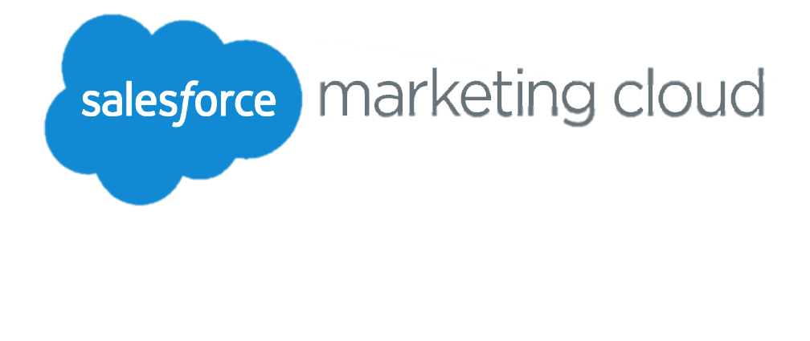
SALESFORCE CAPABILITIES
NONPROFIT EXPERIENCE
Fundraising
Case Mgmt.
Marketing
Programs

Slide 31
Nonprofit Success

Slide 32
HOW WE SUPPORT YOUR ORGANIZATION
Let us be the compass that helps guide your Salesforce journey. We’ve created multiple options of ongoing support to improve your organizational technology success.
Basic
Concierge
Strategic
Empowering your existing Salesforce administrator with on-demand help with your existing packages, integrations and third-party applications.
A designated support resource to act as an extension of your team. This includes proactive issue resolution, enhancement services and ongoing user enablement.
Strategic partnership with Cloud for Good providing thought leadership, technology and organizational strategic planning, as well as hands-on system enhancement.

Slide 33
MAKING SMARTER DECISIONS WITH DATA
According to our State of Salesforce, one of the main objectives for nonprofits and educational institutions during the upcoming year was to improve their reporting.

